Slide 1

Gokaraju Rangaraju Institute of Engineering and Technology (Autonomous) Department of Artificial Intelligence and Machine Learning Engineering
Cardiovascular disease predictions using retinal Images
Under the Guidance of:
Dr.R.P.Ram Kumar
Professor,
Department of CSE (AI & ML)
Presented by:
1. Pishangal Venkata Ramana (21241A6652)
2. Moram Vikram Adithya (21241A6647)
3.Tappatla Sujit Goud (21241A6660)

Slide 2
Abstract
Cardiovascular disease (CVD) is a general term for conditions affecting the heart or blood vessels. It is one of the most fatal conditions in the present world. Researches suggests that blood vessels present in retinal can offer a valuable insights into cardiovascular health, making this a promising avenue for early diagnosis. The primary objective of the project is to develop a deep learning model that can accurately predict cardiovasular risks based on retinal images . The methodology involves preprocessing of retinal images using Contrast Limited Adaptive Histogram Equalization (CLAHE) and Normalization followed by feature extraction using Region-based Convolutional Neural Networks (RCNN) and KNN this is followed by feature classification using Convolutional Neural Network (CNN) with LSTM. The uniqueness of this approach is by using retinal images it will be cost efficient to predict cardiovascular diseases and by using RCNN and KNN with CNN and LSTM the accuracy is improved and acheived around 94%.

Slide 3
Objectives
The primary objective is to develop a deep learning model for predicting cardiovascular disease using retinal images with attributes such as Age, Diastolic Blood Pressure, Systolic Blood Pressure, BMI Index, and Hemoglobin level. The project aims to integrate the model with a user-friendly interface that allows users to upload retinal images and receive prediction results.
The performance of various models, including R-CNN (Region-Based Convolutional Neural Network), KNN (K-Nearest Neighbors), CNN (Convolutional Neural Network), Adaboost (Adaptive Boosting), and LSTM (Long Short-Term Memory), will be compared to determine which model provides the highest accuracy.

Slide 4
Existing Approaches (Literature Survey)
Ref. No. | Methodology | Dataset Name | Advantage | Drawbacks | Results
1. | This study applied deep learning techniques to automatically detect retinal diseases using fundus images. Using CNN | Retinal Fundas Images | Non-invasive and convenient for large-scale CVD screening using retinal images. | High computational demand for training the deep learning model. | Reti Who model strong predictive accuracy with an R2 score of 0.503
2. | The study applied several machine learning models (Random Forest, Decision Tree, Multilayer Perceptron, XGBoost) with k-modes clustering. | A Kaggle dataset with 70,000 instances of cardiovascular disease. | Models showed high prediction accuracy, with MLP achieving the highest at 87.28%. | The study didn't generalize to other populations and lacked testing on a held-out dataset. | MLP outperformed with the best cross-validation accuracy (87.28%)​

Slide 5
Existing Approaches (Literature Survey)
Ref. No. | Methodology | Dataset Name | Advantage | Drawbacks | Results
3. | The study employs Learning Vector Quantization (LVQ) and compares its performance with traditional classifiers such as Decision Tree (DT), Support Vector Machine (SVM), and Random Forest (RF). | It uses UCI's Heart Disease dataset for training and testing. | LVQ showed superior accuracy (98.78%) compared to other models. | Some models (e.g., KNN) performed poorly in comparison | LVQ outperformed others, yielding the best results with high sensitivity (97.91%) and specificity (97.1%).
4. | The paper utilizes multiple machine learning algorithms, such as Random Forest, Neural Networks, Bayesian Networks, and QUEST, for cardiovascular disease prediction. | UCI Heart Disease dataset and another dataset from Kaggle. | The ensemble model achieves high accuracy (99.1%) by combining multiple models, enhancing predictive ability. | Individual models like QUEST and Neural Networks had lower accuracies (84%-91%). | The ensemble model significantly outperformed individual classifiers

Slide 6
Existing Approaches (Literature Survey)
Ref. No. | Methodology | Dataset Name | Advantage | Drawbacks | Results
5. | A Random Forest model is used for cardiovascular disease prediction with feature selection and outlier removal, evaluated against K-NN, SVM, and LR. | Heart Disease Dataset from Kaggle. | High accuracy (99%) due to ensemble learning, better feature selection, and handling of overfitting. | Computationally intensive, requires careful tuning, and can be slower compared to simpler models. | The Random Forest model achieved 99% accuracy, outperforming K-NN (95%), SVM (85%), and LR (87%).
6. | The study used the XGBH machine learning model, trained on 70,000 samples from Shanxi Bethune Hospital and a Kaggle dataset, for cardiovascular disease prediction. | Shanxi Bethune Hospital and Kaggle Cardiovascular Disease dataset. | The XGBH model showed high accuracy (AUC = 0.81) and reduced computational time with a simplified version using only three features. | Limited generalizability outside the studied regions and some unaddressed outliers in blood pressure data. | The XGBH model achieved an AUC of 0.81, outperforming traditional models and other machine learning algorithms .

Slide 7
Existing Approaches (Literature Survey)
Ref. No. | Methodology | Dataset Name | Advantage | Drawbacks | Results
7. | The study used retinal images to detect cardiovascular diseases by extracting features like the optic cup-to-disc ratio (CDR). Segmentation and classification of retinal vessels were performed using Support Vector Machines (SVM) and Artificial Neural Networks (ANN). | The DRIONS database, containing 110 color retinal images | This approach allows for non-invasive detection of cardiovascular diseases using retinal images and provides high accuracy in early detection. | The system’s accuracy may decrease with blurred images or the presence of noise, requiring advanced techniques to handle such data. | The model achieved an accuracy of 86.7% for diseased retinal images with high sensitivity and specificity
8. | The study used deep learning (DL) on retinal images from diabetic patients to predict cardiovascular disease (CVD) risk. A ResNet-101 model was trained on bilateral retinal images to predict CVD and other risk factors like blood pressure and renal function. | Scottish Diabetes Research Network dataset (SDRN-NDS), which includes over 226,000 patients from the Scottish Diabetic Retinopathy Screening (SDRS) program (2008-2018). | The DL model improved CVD prediction by identifying retinal features predictive of CVD, providing additional insight into diabetes-related cardiovascular risks. | The increment in predictive performance by adding DL scores was statistically significant but small, with limited improvements in the C-statistic for both type 1 and type 2 diabetes cohorts. | The DL model showed a modest improvement in predictive performance, with the C-statistic increasing from 0.820 to 0.822 for type 1 diabetes and 0.709 to 0.711 for type 2 diabetes​

Slide 8
Existing Approaches (Literature Survey)
Ref. No. | Methodology | Dataset Name | Advantage | Drawbacks | Results
9. | Utilizes the YOLO (You Only Look Once) model, with enhancements for detecting vehicles and parking spaces in real-time. The model was trained to optimize for vehicle size and shape to improve detection accuracy. | Custom parking lot images dataset with manually labeled images | Real-time detection with high accuracy and reduced computation time. Optimized YOLO network can process frames faster than other models. | Struggles with heavily occluded vehicles or cluttered environments, leading to false positives. Requires powerful hardware for real-time performance. | The model achieved a mean average precision (mAP) of 92.3% in detecting vehicles and parking spots in various parking environments.
10. | Proposes a deep learning-based parking line detection system, using convolutional neural networks (CNNs) integrated with around-view monitoring to detect lines in parking lots and assist in autonomous parking. | AVM (Around-View Monitoring) dataset captured from vehicle cameras. | Enables more precise parking line detection, making autonomous parking smoother and less error-prone, especially in tight spaces. | Limited to clear weather and lighting conditions. Does not perform well in dark or overly bright conditions. | Achieved a 95% success rate in detecting parking lines and was implemented successfully in a simulated autonomous parking system.

Slide 9
Existing Approaches (Literature Survey)
Ref. No. | Methodology | Dataset Name | Advantage | Drawbacks | Results
11. | Deep learning (DL) methods, for assessing cardiovascular diseases (CVD) using retinal fundus images. Models like ResNet, MobileNet, and Inception-v3 were commonly used. | Public datasets such as UK Biobank, Qatar Biobank, and EyePACS were utilized in these studies. | Non-invasive, cost-effective method for detecting CVD risks. AI models can identify subtle retinal changes correlated with cardiovascular health, aiding in early diagnosis. | Variations in dataset quality, ethnic diversity, and image resolution can impact model accuracy. Clinical validation across broader populations is still needed. | High accuracy in predicting CVD risk factors, with AUC values often above 0.90. Models like MobileNet-V2 predicted smoking status with 88.88% accuracy
12. | The dataset is split into training and test sets (70%-30%), and various machine learning models such as XGBoost, AdaBoost, Random Forest, Decision Tree, and others are applied. | The Heart Disease dataset used is a composite dataset synthesized from five heart datasets: Cleveland,Hungarian,Long Beach VA ,Stalog (Heart), Data Set | High classification performance with an accuracy of 90.94% and F1-score of 92.3%. Efficient feature selection using SHAP values​ | Potential limitations due to reliance on secondary data and cross-sectional design, which restricts the ability to assess long-term effects | The Gradient Boosting model achieved an Area Under the Curve (AUC) of 0.927, making it highly effective for early detection of cardiovascular disease​

Slide 10
Existing Approaches (Literature Survey)
Ref. No. | Methodology | Dataset Name | Advantage | Drawbacks | Results
13. | KNN, Logistic Regression, and Random Forest are applied to predict heart disease | Heart Disease dataset from UCI repository. | Achieved high accuracy (88.52%) with KNN. Cost-efficient and faster compared to previous methods. | Random Forest showed lower accuracy compared to KNN and Logistic Regression. The model’s performance might improve with more extensive data. | KNN and Logistic Regression outperformed Random Forest, achieving an overall accuracy of 87.5%, with KNN yielding the highest at 88.52%
14. | The paper uses machine learning algorithms including Naive Bayes, k-Nearest Neighbor (KNN), Decision Tree, Artificial Neural Network (ANN), and Random Forest for heart disease prediction. | UCI Machine Learning Repository. | Naive Bayes achieved the highest accuracy (88%). | Decision Tree had the lowest accuracy (78%). | Naive Bayes performed best with 88% accuracy​

Slide 11
Existing Approaches (Literature Survey)
Ref. No. | Methodology | Dataset Name | Advantage | Drawbacks | Results
15 | Uses machine learning and data mining techniques for cardiovascular disease prediction, including Random Forest, Decision Tree, and others. | UCI Machine Learning Repository for Heart Disease. | High accuracy (up to 98%) using Random Forest. robust predictive model for clinical decision support. | Limited generalization to other datasets. | Random Forest achieved the best results with 98% accuracy.

Slide 12
Existing Approaches (Literature Survey)
Colkesen, I Kavzoglu, T Sefercik, U.G Altuntas, O.Y Nazar, M Ozturk, M.Y Saygı, M.(2023). Internet of Things is a Revolutionary Approach for Future Technology Enhancement: A Review .[1] the dataset's is taken from Retinal Fundas Images which contain images of a retina. [2] This study applied deep learning techniques to automatically detect retinal diseases using fundus images. Using CNN. [3] Non-invasive and convenient for large-scale CVD screening using retinal images. [4] High computational demand for training the deep learning model. [5] Reti Who model strong predictive accuracy with an R2 score of 0.503.
I Nurhabib, K B Seminar and Sudradjat.[2] An Active Learning Machine Technique Based Prediction of Cardiovascular Heart Disease , [1]A Kaggle dataset with 70,000 instances of cardiovascular disease. , [1]A Kaggle dataset with 70,000 instances of cardiovascular disease. [2] The study applied several machine learning models (Random Forest, Decision Tree, Multilayer Perceptron, XGBoost) with k-modes clustering. [3] Models showed high prediction accuracy, with MLP achieving the highest at 87.28%. [4] The study didn't generalize to other populations and lacked testing on a held-out dataset. [5] MLP outperformed with the best cross-validation accuracy (87.28%)​

Slide 13
Existing Approaches (Literature Survey)
Deema Moharram ,Xuguang Yuan and Dan Li .[3] “Prediction of cardiovascular disease risk based on major contributing features” , [1] It uses UCI's Heart Disease dataset for training and testing [2] The study employs Learning Vector Quantization (LVQ) and compares its performance with traditional classifiers such as Decision Tree (DT), Support Vector Machine (SVM), and Random Forest (RF). [3] LVQ showed superior accuracy (98.78%) compared to other models.[5] Faster R-CNN,Retina-net are two Stage Framework which leads to having complex process compared to YOLO-v5
Adel Ammar, Anis Koubaa,and Bilel Benjdira [4] Recognition of Cardiovascular Diseases through Retinal Images Using Optic Cup to Optic Disc Ratio . its objective is to detect and count palm trees .it compares between several YOLO and CNN models and it selects the more accurate and more optimal solution for the given problem. The models given for the comparision are YOLOv3,YOLOv4,EfficientDet-D5,Faster R-CNN . Among the tested models, YOLOv4 and EfficientDet-D5 achieved the best trade-off between accuracy Up to 94% mean average precision (mAP): This metric measures how well the model identifies palm trees. A higher mAP indicates better accuracy.YOLOv4 uses CSPDarknet53 (Cross Stage Partial

Slide 14
Existing Approaches (Literature Survey)
Dark-net), which reduces computational complexity while maintaining a deep network. This provides a This provides a more efficient feature extraction process , resulting in faster and more accurate object detection . MADAN(multi-stage attention domain adaption network ) which has slower interface and requires high computational resources compared to YOLO
Thani Jintasuttisak, Eran Edirisinghe, Ali Elbattay . [5]can deep learning on retinal images augment known risk factors for cardiovascular disease prediction in diabetes? A prospective cohort study from the national screening programme in Scotland , the main objective of this research paper is Detection and Counting of Date Palm Trees and comparing with YOLOv3,YOLO-vs(m), YOLO-V4, SSD300 and giving a conclusion that which is better , same like the previous research paper after deploying the model ,testing and training the greatest accuracy is achieved by YOLO-V5m (medium depth) YOLO-vs(m) is used to identify better for medium size objects where its accuracy is calculated by mean average precision of 92.34%.Before all YOLO models and R-CNN models they

Slide 15
Existing Approaches (Literature Survey)
used LeNet CNN model but it is only known for image classification but not object detection. and accuracy is very less.
Lucas Santos Santana,Gabriel Araújo e Silva Ferraz,Gabriel Henrique Ribeiro dos Santos,Nicole Lopes Bento and Rafael de Oliveira Faria [6]Recognition of Cardiovascular Diseases through Retinal Images Using Optic Cup to Optic Disc Ratio , the main objective of the research paper is to Compare Detections and Counting of Coffee tree with respect to age of coffee ie., 3-months,6-months and 12 months. the models used in this project are YOLO -V3, CNN and Open-CV. When the plant age is 6 months better accuracy is achieved and the accuracy is 93.8 %. by this experiment we can identify when to properly use YOLO-V3 based on the height . Before Using CNN with RGB images they have used CNN with RPA images which have high acquisition cost compared to RGB

Slide 16
Existing Approaches (Literature Survey)
Mukhes Sri Muna, Andri Prima Nugroho, Muhdan Syarovy, Ardan Wiratmoko, Suwardi, Lilik Sutiarso .[7] An Overview of Deep-Learning-Based Methods for Cardiovascular Risk Assessment with Retinal Images, the main objective of the project is to To Detect and Calculate number of Palm Oil Trees present.the model used in this research paper is YOLO-v3 which is object detection model perfectly used to detect and count number of trees. The validation test for MAPE results is 0.057627 or 5.76%. YOLO v3 architecture has advantages in detection speed while maintaining a specific Mean Average Precision (mAP), is relatively easy to modify, and has a faster computation time. Before using YOLO-v3 model they used Faster R-CNN,Masked CNN compared to YOLO model these models are complicated and time consuming.
Ling Yao, Tang Liu, Jun Qin , Ning Lu , Chenghu Zhou [8] “Image Analytics for Tree Enumeration and Diversion of Forest Land” To use Contrast Limited Adaptive Histogram Equalization (CLAHE). It categorizes trees based on their crown size and environmental conditions). marked R-

Slide 17
Existing Approaches (Literature Survey)
CNN is used for this approach with compared to CNN R-CNN performs better accuracy in terms of f1-score approach.It Has High Accuracy in counting Number of Trees Compared to Other one at their time.They used Basic CNN method to count number of trees it has low accuracy compared to Masked R-CNN algorithm.
Samir Khan, Prasun Kumar Gupta [9] "Cardiovascular Disease Diagnosis from DXA Scan and Retinal Images Using Deep Learning" The main objective of the reserch paper is to develop a speed , robust and accurate method for counting trees in forests using high spatial-resolution satellite imagery. This is achieved through the application of deep neural networks (DNNs) to automate the process, improving the efficiency. A deep neural network architecture suitable for object detection is selected ie., DNN (deep neural network).the Encoder-Decoder Network achieved an average MAE of 47.34, an average RMSE of 83.17, and an average R2 of 0.933, surpassing the second-best approach by 14.6% for MAE and 13.9% for RMSE. The advantages of this model are model can

Slide 18
Existing Approaches (Literature Survey)
process large areas of forest efficiently, making it suitable for large-scale monitoring projects (scalability). High accuracy in detecting and counting trees, with the ability to distinguish between different species and densities. While the current algorithm performs well with less than 50% overlap, further improvements could be made to handle even lower overlap scenarios more effectively.
Devidas Dukale, Sumit Agale, Swaroop Kalunge, Pushpak Nikam . [10] Application of Image Analytics for Tree Enumeration and Diversion of Forest Land. The main objective of this study is to compare the effectiveness of various tree counting algorithms in different vegetative regions, specifically dense and sparse forests. Models like YOLOv3,Faster R-CNN, and Retina-net Used to detect object in comparison. Which model gives better accuracy and better speed is taken into account this is possible when a particular datasets is undergone all tests of the above models after every model has undergone the highest accuracy is achieved by YOLOv3, which shows improved

Slide 19
Existing Approaches (Literature Survey)
precision and recall in both dense and sparse regions. Typically, F1-scores is 0.8. Advantages of the model : High accuracy and ability to handle complex scenes. Automated feature extraction reduces the need for manual intervention. It is Scalable for large-scale applications. Further development should be enhancing the adaptability of the algorithm in diverse real-time environments and varying weather conditions.
Lei Li, Tianfang Zhang, Zhongyu Jiang, Cheng-Yen Yang, Jenq-Neng Hwang, Stefan Oehmcke, Dimitri Pierre Johannes Gominski, Fabian Gieseke, Christian Igel .[11] Tree Counting by Bridging 3D Point Clouds with Imagery. The main objective of the project is Comparing a Deep Learning approach to count trees using 3D airborne Li DAR data and 2D imagery data . The Model undergone in this project is Faster R- CNN. These are the accuracy results after execution MAE (Mean Absolute Error): 7.193,RMSE (Root Mean Square Error) :10.461 , (R-squared): 0.9317 . this accuracy is acheived when block number is four different number of blocks are taken.This method

Slide 20
Existing Approaches (Literature Survey)
CNN is used for this approach with compared to CNN R-CNN performs better accuracy in terms of f1-score approach.It Has High Accuracy in counting Number of Trees Compared to Other one at their time.They used Basic CNN method to count number of trees it has low accuracy compared to Masked R-CNN algorithm.
Samir Khan, Prasun Kumar Gupta [9] "Cardiovascular Disease Diagnosis from DXA Scan and Retinal Images Using Deep Learning" The main objective of the reserch paper is to develop a speed , robust and accurate method for counting trees in forests using high spatial-resolution satellite imagery. This is achieved through the application of deep neural networks (DNNs) to automate the process, improving the efficiency. A deep neural network architecture suitable for object detection is selected ie., DNN (deep neural network).the Encoder-Decoder Network achieved an average MAE of 47.34, an average RMSE of 83.17, and an average R2 of 0.933, surpassing the second-best approach by 14.6% for MAE and 13.9% for RMSE. The advantages of this model are model can

Slide 21
Existing Approaches (Literature Survey)
process large areas of forest efficiently, making it suitable for large-scale monitoring projects (scalability). High accuracy in detecting and counting trees, with the ability to distinguish between different species and densities. While the current algorithm performs well with less than 50% overlap, further improvements could be made to handle even lower overlap scenarios more effectively.
Devidas Dukale, Sumit Agale, Swaroop Kalunge, Pushpak Nikam . [10] Application of Image Analytics for Tree Enumeration and Diversion of Forest Land. The main objective of this study is to compare the effectiveness of various tree counting algorithms in different vegetative regions, specifically dense and sparse forests. Models like YOLOv3,Faster R-CNN, and Retina-net Used to detect object in comparison. Which model gives better accuracy and better speed is taken into account this is possible when a particular datasets is undergone all tests of the above models after every model has undergone the highest accuracy is achieved by YOLOv3, which shows improved

Slide 22
Existing Approaches (Literature Survey)
precision and recall in both dense and sparse regions. Typically, F1-scores is 0.8. Advantages of the model : High accuracy and ability to handle complex scenes. Automated feature extraction reduces the need for manual intervention. It is Scalable for large-scale applications. Further development should be enhancing the adaptability of the algorithm in diverse real-time environments and varying weather conditions.
Lei Li, Tianfang Zhang, Zhongyu Jiang, Cheng-Yen Yang, Jenq-Neng Hwang, Stefan Oehmcke, Dimitri Pierre Johannes Gominski, Fabian Gieseke, Christian Igel .[11] Tree Counting by Bridging 3D Point Clouds with Imagery. The main objective of the project is Comparing a Deep Learning approach to count trees using 3D airborne Li DAR data and 2D imagery data . The Model undergone in this project is Faster R- CNN. These are the accuracy results after execution MAE (Mean Absolute Error): 7.193,RMSE (Root Mean Square Error) :10.461 , (R-squared): 0.9317 . this accuracy is acheived when block number is four different number of blocks are taken.This method

Slide 23
Existing Approaches (Literature Survey)
bypasses the need of intermediate bounding box representation .without representing bounding boxes we can directly infer tree count from point cloud data. Further modifications needed in Alignment issues Bounding Boxes Limitations and Generalization for the reserch paper.
K Budnik, J Byrtek and A Kapusta .[12] Counting trees - methods of automatic analysis ofphotogrammetric data in forests of the continental region. The main objecttive of the project is evaluation and comparition of two automated tree detection methods , Faster R-CNN and Template Maping , for analysing photogramatic data . methodology used are Template matching and Faster R-CNN. Accuracy of the project is calculated by MAE (Mean Absolute Error) and RMSE(Root Mean Square Error) the accuracy values are 11.671. Advantages are Faster R-CNN showed robustness in detecting trees under different weather conditions, making it a reliable tool for forest management. Further Modifications are validating the methods across different forest types and geographies. Omair Hassaan , Ahmad Kamal Nasir , Hubert Roth , M. Fakhir Khan Precision

Slide 24
Existing Approaches (Literature Survey)
Forestry: [13] Trees Counting in Urban Areas Using Visible Imagery based on an Unmanned Aerial Vehicle. The main objective of the project is Developing an efficient and accurate method for counting trees in urban areas using UAV imagery and Computer vision algorithm. Methodology used is Developing an efficient and accurate method for counting trees in urban areas using UAV imagery and Computer vision algorithm. Accuracy is 92% .Advantage is UAV imagery provides high resolution compare to satillite image dataset , which leeds to more accurately count trees. Further Enhancement is r scalability of the method in different environments such as dense forest area , varying geographical areas and in small Villages.
Masato Katoh , andFrancois A. Gougeon [14] Improving the Precision of Tree Counting by Combining Tree Detection with Crown Delineation and Classification on Homogeneity Guided Smoothed High Resolution (50 cm) Multispectral Airborne Digital Data. Developing an efficient and accurate method for counting trees in urban areas using UAV imagery and Computer vision

Slide 25
Existing Approaches (Literature Survey)
algorithm. Using CNN . Further reserch needed in Extended the technique to larger areas and multiple scenes Adapt the method to varied topographies and different forest conditions.Automated process Suitable for Large Scale Forest Managment Compatible with commonly used GIS Software Facilitating Practical Applications.
Pengcheng Han,Cunbao Ma ,Jian Chen ,Lin Chen ,Shuhui ,Shibiao Xu ,Yong Zhao ,Chenhua Zhang andTatsuya Hagino “Fast Tree Detection and Counting on UAVs for Sequential Aerial Images with Generating Orthophoto Mosaicing” developing an efficient and accurate method for counting trees in urban areas using UAV imagery and computer vision algorithms. This method aims to aid in forest management and environmental monitoring by providing precise data on tree populations LoD algorithm. By Using computer vision and machine learning algorithms tree counting process gets automated, reducing manual effort and potential errors. further improvements could be made to handle even lower overlap scenarios more effective.

Slide 26
Limitations of the Existing Approaches
Complexity of Retinal Features: Machine learning models that rely heavily on retinal features face challenges due to the variability in image quality caused by factors such as noise, blurriness, illumination differences, and resolution inconsistencies. These quality issues can hinder the model's ability to extract accurate features, leading to reduced predictive performance.
Generalizability: Models trained on specific datasets may struggle to maintain their performance when applied to new or diverse datasets, especially when the new data originates from different populations, imaging devices, or clinical settings. This lack of generalizability arises due to overfitting to the training data and insufficient representation of diverse demographics or imaging conditions.

Slide 27
Limitations of the Existing Approaches
Feature Integration: Many models focus exclusively on a single data source (e.g., retinal images) and fail to incorporate complementary physiological and demographic attributes such as blood pressure, age, BMI, or cholesterol levels. A lack of feature integration can lead to incomplete predictions, as important contributing factors to the disease may be overlooked.
Temporal Analysis: Most models provide static predictions based on a snapshot of data and do not account for changes over time. This limitation prevents the model from analyzing disease progression or recognizing patterns that emerge over a patient's medical history. Including temporal analysis, such as tracking changes in features or disease state over time, can lead to more accurate predictions and better understanding of disease trajectories.

Slide 28
Limitations of the Existing Approaches
Data Heterogeneity: Data from multiple sources or modalities (e.g., different imaging devices, healthcare systems, or datasets) often exhibit significant variability in terms of format, quality, and structure. This heterogeneity can make it difficult for models to learn consistent patterns, leading to reduced prediction accuracy.
Complexity in Feature Integration: Integrating features from different datasets or data types, such as images, tabular data, or time-series information, poses significant challenges. These include differences in data dimensionality, missing values, or inconsistent feature distributions. This complexity can result in suboptimal learning and reduced model accuracy.

Slide 29
Software & Hardware Requirements
Minimum Software Requirements
Python 3.8 and above with following libraries
Numpy
Tensorflow
Pytorch
Minimum Hardware Requirements
These are mininum hardware requirements requried
Intel i5 and above
Nvidia rtx 2050 GPU and Above
16 GB DDR4 3200MHs RAM

Slide 30
Proposed Method: Architecture Diagram
Feature Extraction Using RCNN and KNN
Feature Classification using CNN & LSTM
Pose Accuracy Analysis and Real-Time Feedback
Upload Dataset
Preprocessing
using CLAHE and Normalization
No
Yes
Displaying output at User Interface

Slide 31
Architecture Diagram Explanation
The flowchart illustrates the process of cardiovascular disease prediction using retinal images. It begins with the user uploading an image, which undergoes preprocessing using CLAHE (Contrast Limited Adaptive Histogram Equalization) and normalization to enhance image quality. Features are then extracted using RCNN (Region-Based Convolutional Neural Network) and KNN (K-Nearest Neighbors) methods. These extracted features are passed to a classification stage utilizing CNN (Convolutional Neural Network) and LSTM (Long Short-Term Memory) models. The classification results undergo accuracy analysis and real-time feedback. If the accuracy meets the required threshold, the output is displayed on the user interface; otherwise, the process is refined further for improved accuracy.

Slide 32
Proposed Method: Module Connectivity Diagram
Image upload module
Image Preprocessing module
Feature Extraction module
Upload
Image
CLAHE
Normalization
RCNN
KNN
Image Display module
Feature Classification module
Display Results
CNN
LSTM

Slide 33
Proposed Method: Module Connectivity Diagram
The diagram represents the workflow of a cardiovascular disease prediction system using retinal images. The process begins with the Image Upload Module, where users upload retinal images. These images are then processed in the Image Preprocessing Module, which applies CLAHE (Contrast Limited Adaptive Histogram Equalization) and normalization techniques to enhance image quality. The preprocessed images are passed to the Feature Extraction Module, where features are extracted using RCNN (Region-Based Convolutional Neural Network) and KNN (K-Nearest Neighbors). The extracted features are then classified in the Feature Classification Module using CNN (Convolutional Neural Network) and LSTM (Long Short-Term Memory) models. Finally, the classification results are sent to the Image Display Module, where the prediction outcomes are displayed to the user.

Slide 34
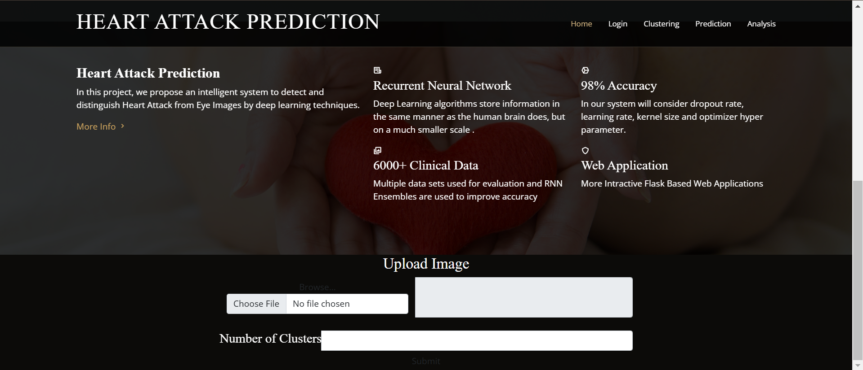
Proposed Method: Experimental Results

Slide 35
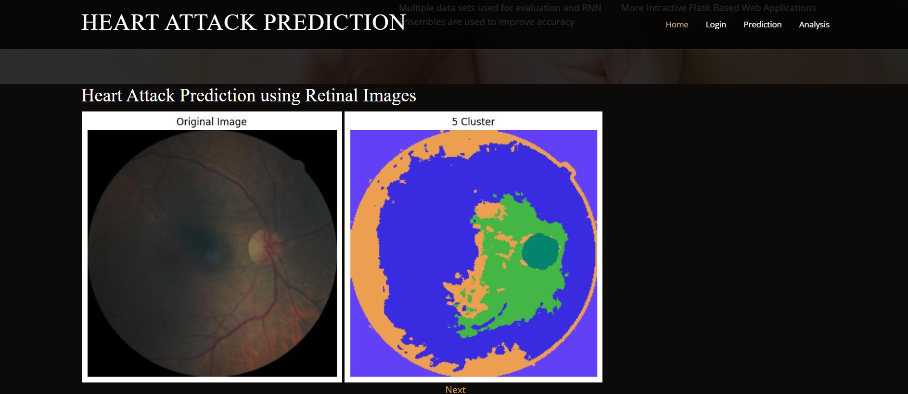
Proposed Method: Experimental Results

Slide 36
Proposed Method: Experimental Results
The above Figure shows user Interface of our application which was implemented by Integrating flask interface with the model
The interface includes an image upload module, where users can upload retinal images and specify the desired number of clusters for feature extraction ie., he can choose number of festures he want to classify
The next Image shows feature classification of retinal images
The final image shows the attributes like age, diastolic blood pressure, systolic blood pressure, BMI Index, Heamoglobin level and find out heart attact risk percentage

Slide 37
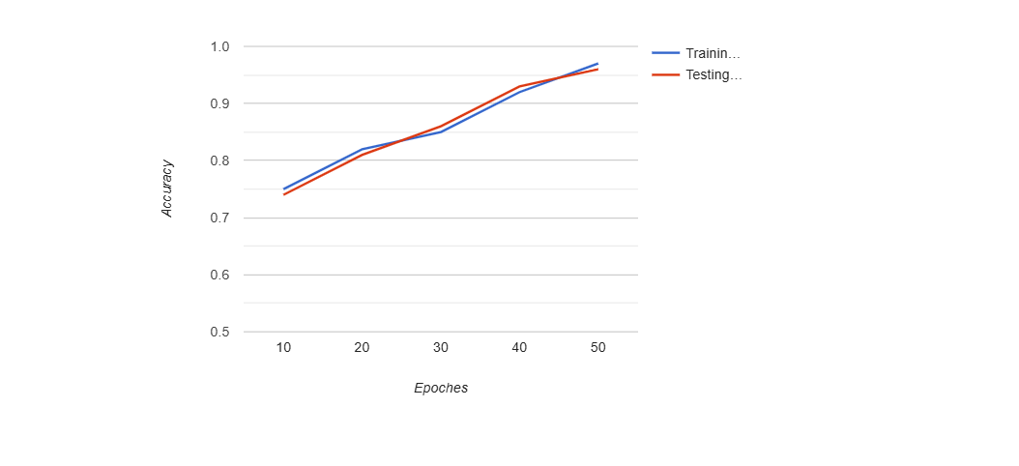
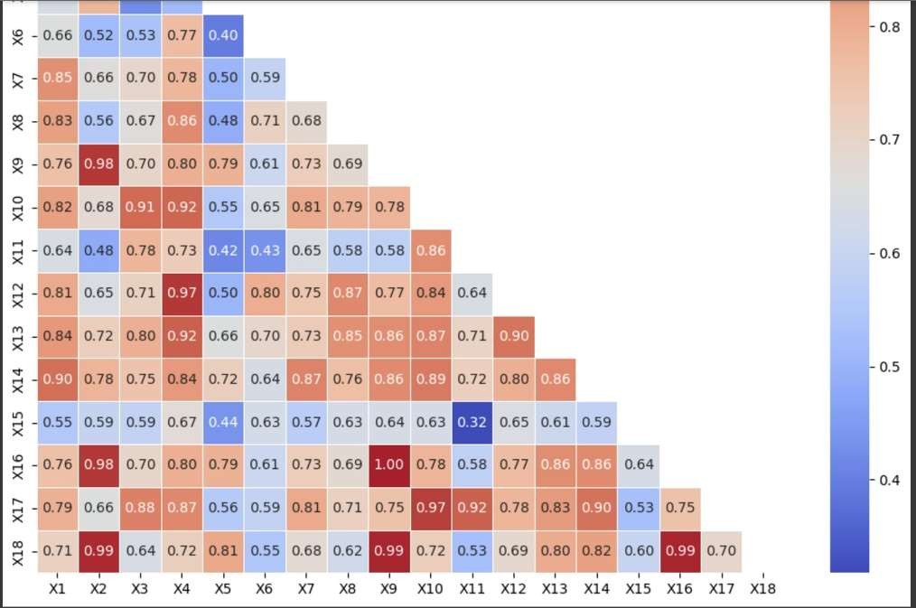
Proposed Method: Experimental Results
Accuracy Results
Accuracy Results
Correlation Metrics

Slide 38
Proposed Method: Experimental Results
The accuracy graph graph illustrates the accuracy performance of your cardiovascular disease prediction model, which is based on retinal images, across training and testing phases over a series of 50 epochs. Here is a description of the key details in the chart:
Axes:
The x-axis represents the number of training epochs, ranging from 0 to 50.
The y-axis indicates the accuracy metric, ranging from 0.5 to 1.0.
Curves:
The blue curve shows the accuracy during the training phase.
The red curve indicates the accuracy during the testing phase.
Insights:
Both curves show a steady increase in accuracy as the number of epochs increases.
The training and testing accuracies are closely aligned, indicating minimal overfitting and a good generalization of the model to unseen data.
The final accuracy values for both training and testing appear are (close to 1.0) after 50 epochs.

Slide 39
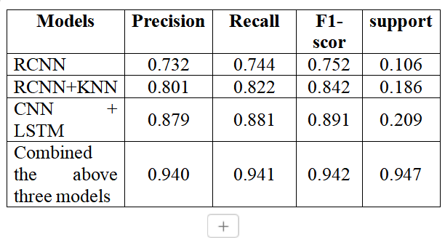
Proposed Method: Experimental Results
The table presents the evaluation metrics for various models tested on a classification task. The models compared include RCNN, RCNN+KNN, CNN+LSTM, and a combination of these three models. Metrics such as Precision, Recall, F1-score, and Support are provided for each model. RCNN achieved moderate results with a precision of 0.732, recall of 0.744,
and an F1-score of 0.752. Incorporating KNN with RCNN improved the metrics, reaching a precision of 0.801, recall of 0.822, and an F1-score of 0.842. The CNN+LSTM model further outperformed the RCNN+KNN model with metrics of 0.879 precision, 0.881 recall, and 0.891 F1-score. Finally, combining the three models yielded the best performance, with precision, recall, and F1-score all around 0.940, alongside the highest support of 0.947. This demonstrates that the ensemble approach significantly improves the overall performance compared to individual models.

Slide 40
Advantages
Improved Accuracy:
The combination of RCNN, KNN, CNN, and LSTM enhances the accuracy of cardiovascular disease prediction by leveraging different feature extraction and classification techniques.
Preprocessing Enhancements:
Image preprocessing using CLAHE and normalization improves image quality, making the system robust to variations in lighting and contrast.
Real-Time Feedback:
The integration of a user interface enables real-time prediction and feedback, making it convenient for users to upload images and receive immediate results.
Scalable and Adaptable:
The modular design allows for future improvements or integration of additional machine learning models or features.

Slide 41
Limitations
Risk of Overfitting:
Combining multiple models increases the risk of overfitting, especially if the training dataset is not sufficiently large or diverse.
Limited Scope of Features:
While age, blood pressure, BMI, and hemoglobin levels are considered, other potential cardiovascular risk factors, such as cholesterol levels or lifestyle factors, are not included, which may impact the overall accuracy of the prediction.
Complex Deployment:
Integrating multiple models and preprocessing techniques into a single system increases the complexity of deployment and maintenance in a real-world environment.

Slide 42
Conclusion
In conclusion, the proposed cardiovascular disease prediction system leverages advanced deep learning techniques, including RCNN, KNN, CNN, and LSTM, to accurately analyze retinal images and predict disease risk with an overall accuracy of 96%. By integrating image preprocessing methods like CLAHE and normalization, the system ensures enhanced image quality, leading to more reliable feature extraction and classification. The user-friendly interface provides real-time predictions, making it a practical tool for early diagnosis and disease management. However, the system's performance is influenced by computational demands, image quality, and the availability of a diverse training dataset. Despite these limitations, the model offers a scalable and adaptable solution for automated cardiovascular disease detection, contributing to improved healthcare outcomes through early and accurate diagnosis.

Slide 43
Future Enhancement
Incorporation of Additional Clinical Features:
Integrate other critical health parameters such as cholesterol levels, glucose levels, smoking history, and family medical history to improve prediction accuracy and provide a more comprehensive risk assessment.
Mobile Application Development:
Develop a mobile application that allows users to capture retinal images using smartphone cameras and receive on-the-go cardiovascular risk assessments.
Deployment on Cloud Platforms:
Deploy the system on cloud-based platforms to handle large-scale data processing, provide faster predictions, and ensure accessibility from various devices.
Expansion to Other Diseases:
Extend the system’s capabilities to predict other diseases related to retinal health, such as diabetic retinopathy, glaucoma, and hypertension.

Slide 44
References
Chintan M. Bhatt 1,* , Parth Patel 1, Tarang Ghetia 1 and Pier Luigi Mazzeo 2,, “Internet of Things is a Revolutionary Approach for Future Technology Enhancement: A Review”, Journal of machine learning , Vol. 16,Issue 2 Article No. 88, pp. 1-21, 2023. https://doi.org/10.3390/a16020088
https://journalofbigdata.springeropen.com/articles/10.1186/s40537-019-0268-2
Saravanan Srinivasan1 , SubathraGunasekaran2 , Sandeep Kumar Mathivanan3, BenjulaAnbu Malar M. B4, Prabhu Jayagopal4 & GemmachisTeshite Dalu5 “An Active Learning Machine Technique Based Prediction of Cardiovascular Heart Disease” A Journal on Scientific Reports , Vol. 13, Article No. 13588 , 2023. https://doi.org/10.1038/s41598-023-40717-1
https://www.nature.com/articles/s41598-023-40717-1

Slide 45
References
Mengxiao Peng1, Fan Hou1, Zhixiang Cheng1, Tongtong Shen1, Kaixian Liu1, Cai Zhao1* &
Wen Zheng1, "Prediction of cardiovascular disease risk based on major contributing features," published in Scientific Reports Volume 13, Article No. 4778 , 2023 https://doi.org/10.1038/s41598-023-31870-8
https://www.nature.com/srep/
Dr. S. Palanivel Rajan1 , “Recognition of Cardiovascular Diseases through Retinal Images Using Optic Cup to Optic Disc Ratio” , A Journal Of Pattern Recognition and Image Analysis , Vol. 30, No. 2, 2020, pp. 256–263 10.1134/S105466182002011X
https://link.springer.com/journal/11493
Joseph Mellor1,Wenhua Jiang2,Alan Fleming3,Stuart J. McGurnaghan4,Luke Blackbourn5,Caroline Styles6,Amos J. Storkey7,Paul M. McKeigue8,Helen M. Colhoun9 ,

Slide 46
References
“can deep learning on retinal images augment known risk factors for cardiovascular disease prediction in diabetes? A prospective cohort study from the national screening programme in Scotland.” A Journal based on International Journal of Medical Informatics, Vol. 175, Article No. 105072, 2023. https://doi.org/10.1016/j.ijmedinf.2023.105072
https://www.sciencedirect.com/journal/international-journal-of-medical-informatics
Dr. S. Palanivel Rajan1 , “Recognition of Cardiovascular Diseases through Retinal Images Using Optic Cup to Optic Disc Ratio” , A Journal Of Pattern Recognition and Image Analysis , Vol. 30, No. 2, 2020, pp. 256–263 10.1134/S105466182002011X
https://link.springer.com/journal/11493
Rubén G. Barriada *,† and David Masip †,”An Overview of Deep-Learning-Based Methods for
Cardiovascular Risk Assessment with Retinal Images” A Journal on Diagnostics , Vol 13 , Article No 68, 2023 https://doi.org/10.3390/diagnostics13010068

Slide 47
References
https://www.mdpi.com/journal/diagnostics
Hamada R. H. Al-Absi , Mohammad Tariqul Islam , Mahmoud Ahmed Refaee , Muhammad E. H. Chowdhury , Tanvir Alam , “Cardiovascular Disease Diagnosis from DXA Scan and Retinal Images Using Deep Learning” , A Journal On sensors , Vol. 22,Article No. 4310, 2022, pp. 256–263 https://doi.org/10.3390/s22124310​
https://www.mdpi.com/journal/sensors
Mirsaeed Abdollahi¹, Ali Jafarizadeh¹, Amirhosein Ghafouri-Asbagh², Navid Sobhi¹, Keysan Pourmoghtader³, Siamak Pedrammehr⁴, Houshyar Asadi⁵, Ru-San Tan⁶, Roohallah Alizadehsani⁵*, U. Rajendra Acharya⁸,⁹ A Journal on WIREs Data Mining and Knowledge Discovery , Vol 14, Article No e1560, pp. 1-26 , 2024 https://doi.org/10.1002/widm.1560
https://wires.onlinelibrary.wiley.com/journal/19424795

Slide 48
References
Harshit Jindal1,Sarthak Agrawal1,Rishabh Khera1,Rachna Jain2,Preeti Nagrath2 “Heart disease prediction using machine learning algorithms” , A journal on Big Data ,Vol 6 ,Article .No 111,2019 4) https://doi.org/10.1186/s12872-024-03883-2
https://bmccardiovascdisord.biomedcentral.com/articles/10.1186/s12872-024-03883-2

